Slide 1
ASSOCIATION BETWEEN INTERVAL-RATIO VARIABLES

Slide 2
Scattergrams
Allow quick identification of important features of relationship between interval-ratio variables
Two dimensions:
Scores of the independent (X) variable (horizontal axis)
Scores of the dependent (Y) variable (vertical axis)
Notes:
(

Slide 3
3 Purposes of Scattergrams
To give a rough idea about the existence, strength & direction of a relationship
The direction of the relationship can be detected by the angle of the regression line
2. To give a rough idea about whether a relationship between 2 variables is linear (defined with a straight line)
3. To predict scores of cases on one variable (Y) from the score on the other (X)

Slide 4
IV and DV?
What is the direction
of this relationship?

Slide 5
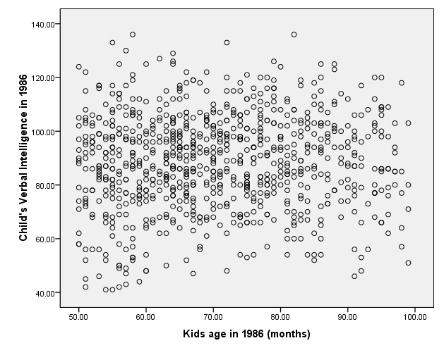
IV and DV?
What is the direction of this relationship?

Slide 6
The Regression line
Properties:
The sum of positive and negative vertical distances from it is zero
The standard deviation of the points from the line is at a minimum
The line passes through the point (mean x, mean y)
Bivariate Regression Applet

Slide 7
Regression Line Formula
Y = a + bX
Y = score on the dependent variable
X = the score on the independent variable
a = the Y intercept –
point where the regression line crosses the Y axis
b = the slope of the regression line
SLOPE – the amount of change produced in Y by a unit change in X; or,
a measure of the effect of the X variable on the Y

Slide 8
Regression Line Formula
Y = a + bX
y-intercept (a) = 102
slope (b) = .9
Y = 102 + (.9)X
This information can be used to predict weight from height.
Example: What is the predicted weight of a male who is 70” tall (5’10”)?
Y = 102 + (.9)(70) = 102 + 63
= 165 pounds
Notes:
EXAMPLE WITH HEIGHT WEIGHT….
SAMPLE OF MALES
INTERPRETATION OF THIS SLOPE:
FOR EACH 1-INCH INCREASE IN HEIGHT, WEIGHT INCREASES 0.9 OF A POUND.
QUESTIONS?
PUT THIS ON THE BOARD:
Y = 102 + (.9)(70) = 102 + 63
= 165 pounds

Slide 9
Example 2: Examining the link between # hours of daily TV watching (X) & # of cans of soda consumed per day (Y)
Case | # Hours TV/ Day (X) | Cans Soda Per Day (Y)
1 | 1 | 2
2 | 3 | 6
3 | 2 | 3
4 | 2 | 4
5 | 1 | 1
6 | 4 | 6
7 | 6 | 7
8 | 4 | 2
9 | 4 | 5
10 | 2 | 0

Slide 10
Example 2
Example 2: Examining the link between # hours of daily TV watching (X) & # of cans of soda consumed per day. (Y)
The regression line for this problem:
Y = 0.7 + .99x
If a person watches 3 hours of TV per day, how many cans of soda would he be expected to consume according to the regression equation?
Notes:
y intercept (a) is 0.7 & slope (b) is .99

Slide 11
The Slope (b) – A Strength & A Weakness
We know that b indicates the change in Y for a unit change in X, but b is not really a good measure of strength
Weakness
It is unbounded (can be >1 or <-1) making it hard to interpret
The size of b is influenced by the scale that each variable is measured on

Slide 12
Pearson’s r Correlation Coefficient
By contrast, Pearson’s r is bounded
a value of 0.0 indicates no linear relationship and a value of +/-1.00 indicates a perfect linear relationship

Slide 13
Pearson’s r
Y = 0.7 + .99x
s_{x} = 1.51
s_{y} = 2.24
Converting the slope to a Pearson’s r correlation coefficient:
Formula: r = b(s_{x}/s_{y})
r = .99 (1.51/2.24)
r = .67
Notes:
SIMPLE FORMULA TO TRANSFORM A b INTO AN r…
Strong positive relationship between x & y.
So, Pearson’s r is superior to b (the slope) for discussing the association between two interval-ratio variables in that Pearson’s r is bounded (score of -1 to 1).
The major advantage of this is that you can look at the association b/t two variables with very different scales.

Slide 14
The Coefficient of Determination
The interpretation of Pearson’s r (like Cramer’s V) is not straightforward
What is a “strong” or “weak” correlation?
Subjective
The coefficient of determination (r²) is a more direct way to interpret the association between 2 variables
r² represents the amount of variation in Y explained by X
You can interpret r² with PRE logic:
predict Y while ignoring info. supplied by X
then account for X when predicting Y

Slide 15
Coefficient of Determination: Example
Without info about X (hours of daily TV watching), the best predictor we have is the mean # of cans of soda consumed (mean of Y)
The green line (the slope) is what we would predict WITH info about X
Notes:
BOARD: MEAN # OF CANS OF SODA CONSUMED IS 3.6. IF WE DIDN’T HAVE INFO ON X, THIS WOULD BE OUR BEST PREDICTION.
THIS LINE COMES VERY CLOSE TO SOME POINTS, BUT IS QUITE FAR AWAY FROM OTHERS.
If we know nothing about x, what is our best guess about the number of self-reported crimes that they are engaged in?
Our “best guess” will always be the mean value of y (variation around the mean is always a minimum).
This is because the scores of any variable vary less around the mean than around any other point.
If we predict the mean of Y for every case, we will make fewer errors of prediction than if we predict any other value for Y. In other words, squared deviations from a mean are at a minimum:
∑(Y-Y)2 = minimum
BOARD: VARIATION AROUND THE MEAN IS ALWAYS THE MINIMUM POSSIBLE
So, if we knew nothing about X, the squared deviations from our prediction will sum up to the total variation in y.
The vertical lines from the actual scores to the predicted score (Y bar) represent the amount of error we would make when predicting Y while ignoring X.
THIS IS TOTAL VARIATION IN Y.
Now, when we know X, we can calculate a regression equation and make predictions about Y using the regression coefficient.
If the two variables have a linear relationship, then predicting scores on Y from the least squares regression equation will incorporate X and improve our ability to predict Y.
So, our next step is to determine the extent to which knowledge of X improves our ability to predict Y.
This sum is called the explained variation – tells us how our ability to predict Y when taking X into account.
It is a measure of how much better our prediction has gotten (as opposed to just using the mean of y. In other words, it represents the proportion of the variation in y that is explained by x).
VERTICAL LINES (REPRESENTING ERROR BETWEEN PREDICTED & OBSERVED) ARE SHORTER

Slide 16
Coefficient of Determination
Conceptually, the formula for r² is:
r² = Explained variation
Total variation
“The proportion of the total variation in Y that is attributable or explained by X.”
The variation not explained by r² is called the unexplained variation
Usually attributed to measurement error, random chance, or some combination of other variables
Notes:
The formula for r2 is explained variation/total variation – that is, the proportion of the total variation in Y that is attributable to or explained by X.
Just like other PRE measures, r2 indicates precisely the extent to which x helps us predict, understand, or explain X (much less ambiguous than r).
The variation that is not explained by x (1-r2) is referred to as the unexplained variation (or, the difference between our best prediction of Y with X and the actual scores.
Unexplained variation is usually attributed to the influence of some combination of other variables
(THIS IS HUGE, AND IS SOMETHING YOU’LL BE GETTING INTO A LOT MORE IN 3152 – RARELY IN THE “REAL” SOCIAL WORLD CAN ALL VARIATION IN A FACTOR BE EXPLAINED BY JUST ONE OTHER FACTOR – THE ECONOMY, CRIME, ETC ARE COMPLEX PHENOMENA),
measurement error, or random chance.

Slide 17
Coefficient of Determination
Interpreting the meaning of the coefficient of determination in the example:
Squaring Pearson’s r (.67) gives us an r² of .45
Interpretation:
The # of hours of daily TV watching (X) explains 45% of the total variation in soda consumed (Y)
Notes:
So, to continue with our example, squaring the Pearson’s r for the relationship b/t # of children in a family & number of self-reported crimes committed in a 6-month span gives us an r2 of…
INTERPRETATION: ANOTHER PRE-BASED MEASURE…
On the other hand, maybe there’s another variable out there that does a better job at predicting how many crimes a person commits. Perhaps, for example, it is the number of delinquent peers they hang out with, or if they hang out with any delinquent peers.
In this case, the r2 might be higher for another factor.
In multiple regression, we can consider both simultaneously – have 2 x’s predicting or explaining variation in the same y.
(PRELUDE TO MULTIVARIATE REGRESSION)

Slide 18
Another Example: Relationship between Mobility Rate (x) & Divorce rate (y)
The formula for this regression line is:
Y = -2.5 + (.17)X
1) What is this slope telling you?
2) Using this formula, if the mobility rate for a given state was 45, what would you predict the divorce rate to be?
3) The standard deviation (s) for x=6.57 & the s for y=1.29. Use this info to calculate Pearson’s r. How would you interpret this correlation?
4) Calculate & interpret the coefficient of determination (r²)
Notes:
MOBILITY RATES OF STATES

Slide 19
Another Example: Relationship between Mobility Rate (x) & Divorce rate (y)
The formula for this regression line is:
Y = -2.5 + (.17)X
1) What is this slope telling you?
2) Using this formula, if the mobility rate for a given state was 45, what would you predict the divorce rate to be?
3) The standard deviation (s) for x=6.57 & the s for y=1.29. Use this info to calculate Pearson’s r. How would you interpret this correlation?
4) Calculate & interpret the coefficient of determination (r²)
Notes:
MOBILITY RATES OF STATES

Slide 20
Regression Output
Scatterplot
Graphs → Legacy → Simple Scatter
Regression
Analyze → Regression → Linear
Example: How much you work predicts how much time you have to relax
X = Hours worked in past week
Y = Hours relaxed in past week

Slide 21
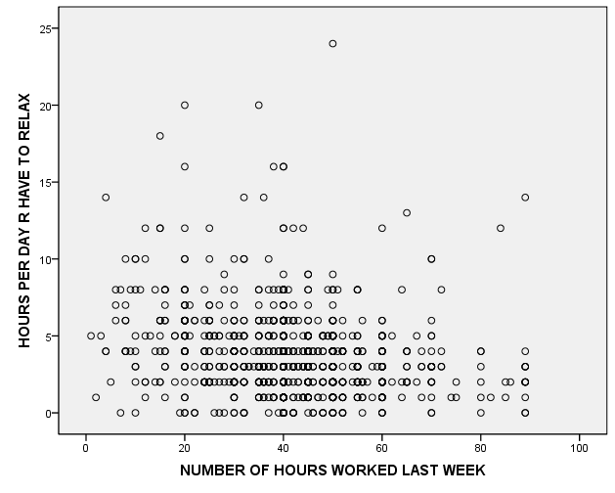
Hours worked x Hours relaxed

Slide 22
Regression Output
Model Summary
Model |  | R | R Square | Adjusted R Square | Std. Error of the Estimate
dimension0 | 1 | .209ª | .044 | .043 | 2.578
a. Predictors: (Constant), NUMBER OF HOURS WORKED LAST WEEK
Coefficientsª
Model |  | Unstandardized Coefficients |  | Standardized Coefficients | t | Sig.
 |  | B | Std. Error | Beta
1 | (Constant) | 5.274 | .236 |  | 22.38 | .000
 | NUMBER OF HOURS WORKED LAST WEEK | -.038 | .005 | -.209 | -7.160 | .000
a. Dependent Variable: HOURS PER DAY R HAVE TO RELAX

Slide 23
Correlation Matrix
Analyze → Correlate → Bivariate
Correlations
 |  | NUMBER OF HOURS WORKED LAST WEEK | HOURS PER DAY R HAVE TO RELAX | DAYS OF ACTIVITY LIMITATION PAST 30 DAYS
NUMBER OF HOURS WORKED LAST WEEK | Pearson Correlation | 1 | -.209** | -.061*
 | Sig. (2-tailed) |  | .000 | .040
 | N | 1139 | 1123 | 1122
HOURS PER DAY R HAVE TO RELAX | Pearson Correlation | -.209** | 1 | -.021
 | Sig. (2-tailed) | .000 |  | .483
 | N | 1123 | 1154 | 1146
DAYS OF ACTIVITY LIMITATION PAST 30 DAYS | Pearson Correlation | -.061* | -.021 | 1
 | Sig. (2-tailed) | .040 | .483
 | N | 1122 | 1146 | 1155
**. Correlation is significant at the 0.01 level (2-tailed).
*. Correlation is significant at the 0.05 level (2-tailed).

Slide 24
Measures of Association
Level of Measurement (both variables) | Measures of Association | “Bounded”? | PRE interpretation?
NOMINAL | Phi Cramer’s V Lambda | NO* YES YES | NO NO YES
ORDINAL | Gamma | YES | YES
INTERVAL-RATIO | b (slope) Pearson’s r r² | NO YES YES | NO NO YES
* But, has an upper limit of 1 when dealing with a 2x2 table.

